Slide 1
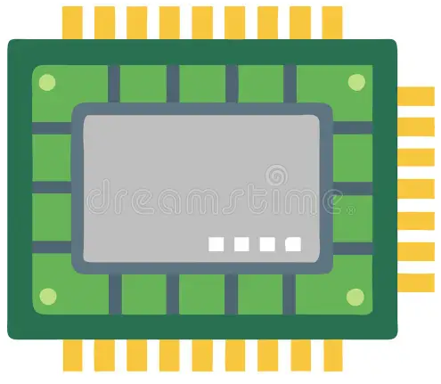
FPGA-Based Real-Time Driver Drowsiness Detection Using RISC-V and Hardware Acceleration
S K Hari Kheshav CS24S025
Department of Computer Science and Engineering
Saptajit Banerjee ID25S001
School of Interdisciplinary Studies
K Srirag ID25S030
School of Interdisciplinary Studies

Slide 2
System Architecture (Software)
Start
CARLA
Drive Car
(Manual Mode)
Capture Frames
Extract Faces
(Media Pipe)
Drowsiness Detection
One Minute Buffer
FALSE
TRUE
Drive Car
(Autonomous Mode)
If >=70% of Detections Drowsy
Switch to Manual Mode
TRUE
FALSE

Slide 3

Software Demo

Slide 4
Optimization Pipelines
Standard Optimization Pipeline (TFMOT)
ONNX Optimization Pipeline
Model Size Reduction
Latency Reduction
Model Training
Performance Gain: Achieved 8x higher throughput ↑ and 6.5x lower latency ↑
Accuracy Collapse: After Quantization, Observed a drop from 99% to 55% ↓ with marginal throughput and latency degradation
The Solution: Hybridized TFLite Quantization with the ONNX pipeline
Expected Result: Restored precision with 90%+ accuracy retention for FPGA
Model Training
Model Compression : Achieved 6x size reduction ↑ via the TFMOT pipeline
The Bottleneck : Observed 17x higher latency ↓ and 11x lower throughput ↓ in Keras
The Solution : Migrated to ONNX to bypass high-level software overhead
Hardware Fusion : Combined model layers to restore real-time performance for FPGA
MLIR
Optimization
Pruning
ONNX Conversion
Clustering
ONNX Simplification
Quantization
Static INT8 Quantization

Slide 5
Merged Optimization Pipeline
Model Training
Pruning
Clustering
ONNX
Optimization
On Clustered Model
Full Quantization by ONNX Runtime
Accuracy Collapsed After Full Quantization
On Clustered Model
ONNX
Optimization
Quantization
TRUE
On Partially Quantized Model
Partial Quantization by TFLite Converter
FALSE
STOP

Slide 6
Performance Report (Partially Quantized Models)
MobileNetV3 Small | Throughput | Accuracy | Model Size (Raw) | Model Size (ZIP) | Latency
Original | 24.1 Imgs/sec | 99.14% | 31.20 MB | 28.24 MB | 41.54 ms
Pruning | 16.7 Imgs/sec | 99.14% | 12.50 MB | 7.09 MB | 59.73 ms
Clustering | 15.6 Imgs/sec | 98.90% | 12.38 MB | 1.90 MB | 64.17 ms
Partial Quanitzation | 9.73 Imgs/sec | 93.83% | 3.22 MB | 1.53 MB | 102.73 ms
Simplified FP32 ONNX | 80.38 Imgs/sec | 96.88% | 3.18 MB | 1.48 MB | 12.44 ms
Fully Quantized ONNX | 202.52 Imgs/sec | 47.16% | 3.21 MB | 1.49 MB | 4.94 ms
MobileNetV3 Large | Throughput | Accuracy | Model Size (Raw) | Model Size (ZIP) | Latency
Original | 24.7 Imgs/sec | 98.76% | 47.43 MB | 41.17 MB | 40.56 ms
Pruning | 14.9 Imgs/sec | 98.76% | 23.96 MB | 16.95 MB | 67.30 ms
Clustering | 14.8 Imgs/sec | 99.90% | 23.81 MB | 4.24 MB | 67.36 ms
Partial Quanitzation | 3.17 Imgs/sec | 76.37% | 6.22 MB | 3.63 MB | 315.50 ms
Simplified FP32 ONNX | 45.43 Imgs/sec | 100.00% | 6.05 MB | 3.50 MB | 22.02 ms
Fully Quantized ONNX | 119.61 Imgs/sec | 52.92% | 6.07 MB | 3.26 MB | 8.36 ms

Slide 7
Performance Report (Fully Quantized Models)
ResNet - 18 | Throughput | Accuracy | Model Size (Raw) | Model Size (ZIP) | Latency
Original | 25.9 Imgs/sec | 99.86% | 128.40 MB | 118.27 MB | 38.67 ms
Pruning | 25.7 Imgs/sec | 99.86% | 42.89 MB | 39.61 MB | 36.37 ms
Clustering | 45.8 Imgs/sec | 99.90% | 42.87 MB | 9.39 MB | 21.84 ms
Simplified FP32 ONNX | 56.44 Imgs/sec | 99.58% | 42.64 MB | 39.53 MB | 17.72 ms
Fully Quantized ONNX | 76.44 Imgs/sec | 99.79% | 10.72 MB | 10.15 MB | 13.08 ms
RTDD (IEEE) | Throughput | Accuracy | Model Size (Raw) | Model Size (ZIP) | Latency
Original | 25.2 Imgs/sec | 99.90% | 337.18 MB | 312.66 MB | 39.69 ms
Pruning | 135.3 Imgs/sec | 99.81% | 112.42 MB | 39.20 MB | 7.39 ms
Clustering | 135.1 Imgs/sec | 99.76% | 112.41 MB | 7.94 MB | 7.40 ms
Simplified FP32 ONNX | 6.08 Imgs/sec | 99.79% | 112.37 MB | 39.19 MB | 164.57 ms
Fully Quantized ONNX | 7.06 Imgs/sec | 99.79% | 28.13 MB | 10.76 MB | 141.63 ms

Slide 8
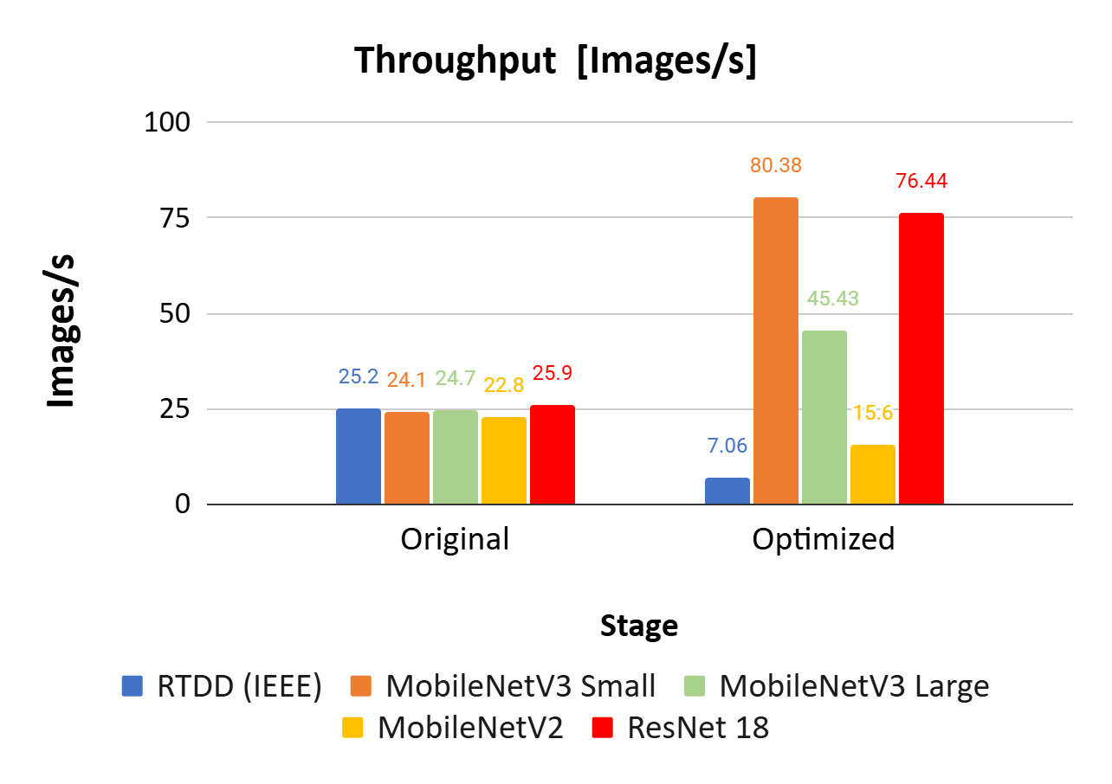
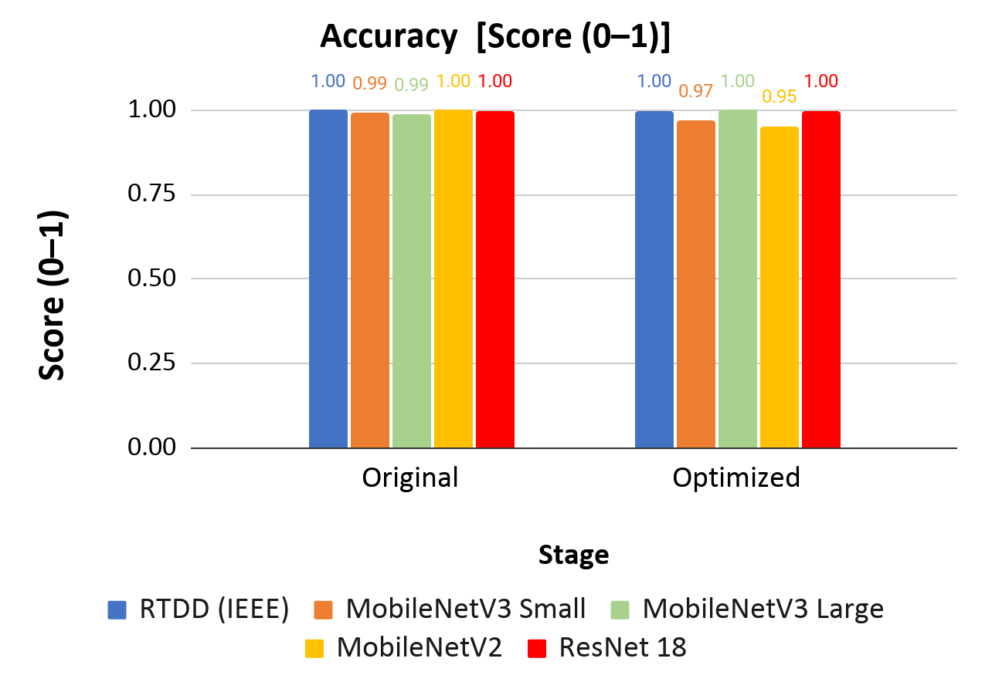
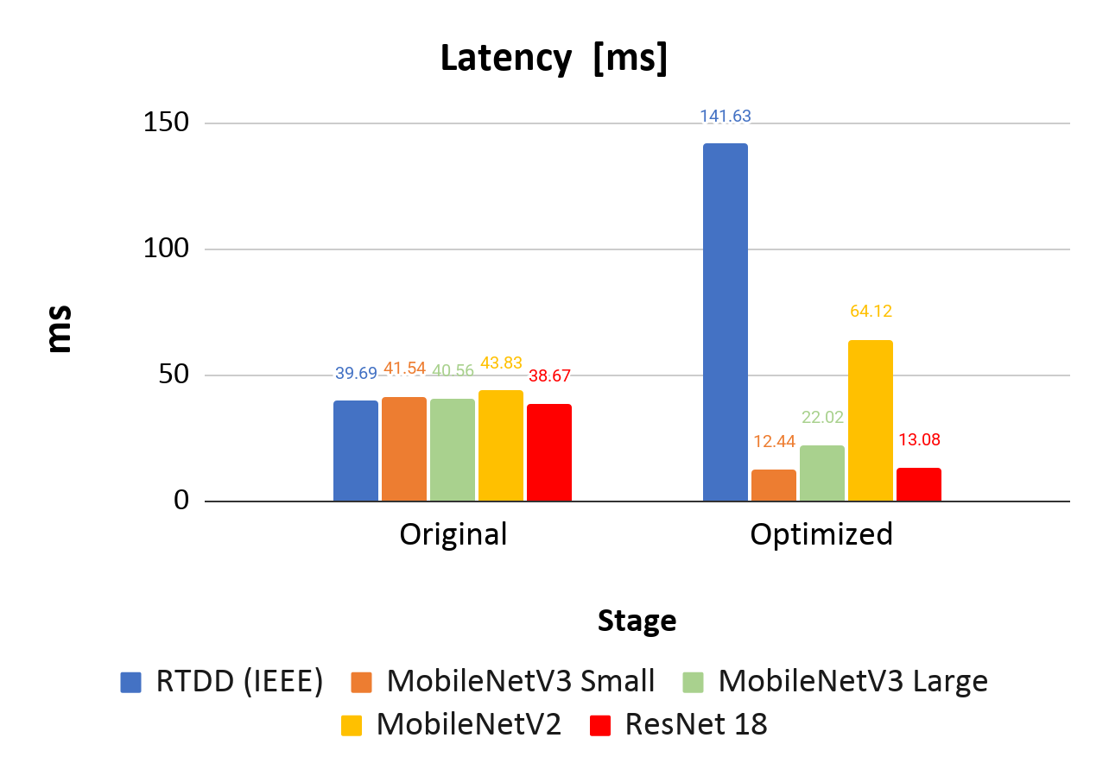
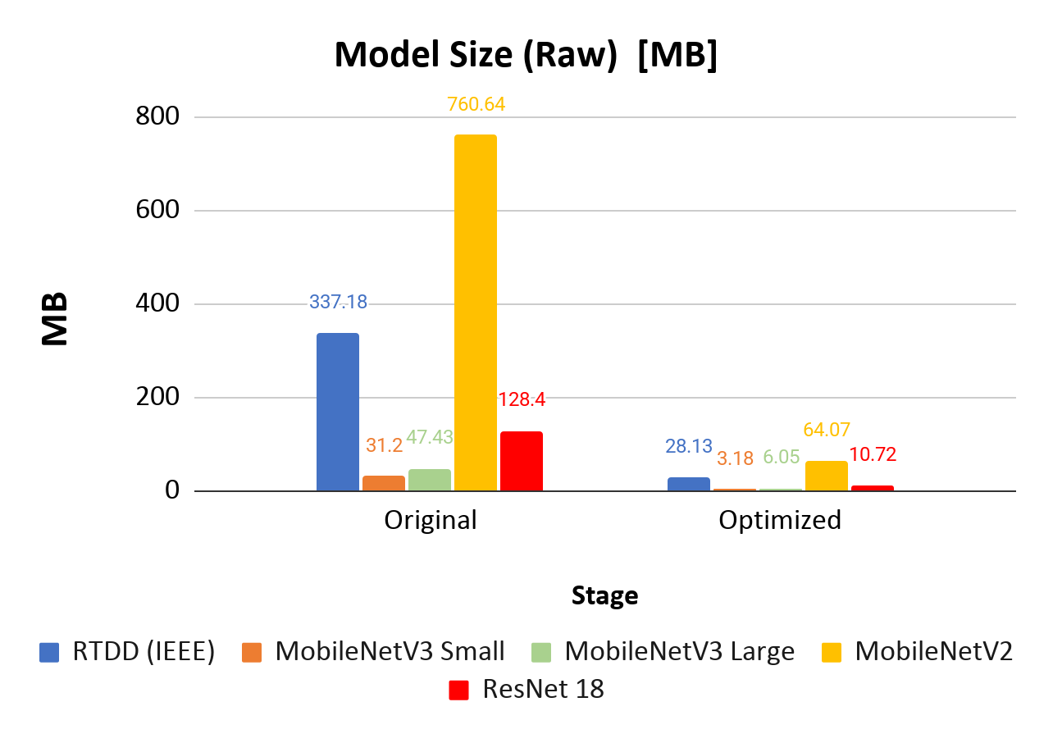
Performance Gains Across Models
Throughput : Three of five models achieved substantial throughput gains following optimization. MobileNetV3 Small delivered the highest improvement at +233% (24.1 → 80.38 img/s), followed by ResNet 18 at +195% (25.9 → 76.44 img/s) and MobileNetV3 Large at +84% (24.7 → 45.43 img/s).
Latency : Inference latency was significantly reduced in three models. MobileNetV3 Small achieved a 70% latency reduction (41.54 → 12.44 ms), ResNet 18 a 66% reduction (38.67 → 13.08 ms), and MobileNetV3 Large a 46% reduction (40.56 → 22.02 ms), making them viable for real-time edge deployment.
Model Size Reduction : All five models achieved drastic reductions in model size, averaging over 90% compression of raw model size. The most significant reduction was seen in MobileNetV2, shrinking from 760.64 MB to 64.07 MB (−92%), followed by RTDD (IEEE) from 337.18 MB to 28.13 MB (−92%) and ResNet 18 from 128.40 MB to 10.72 MB (−92%).

Slide 9
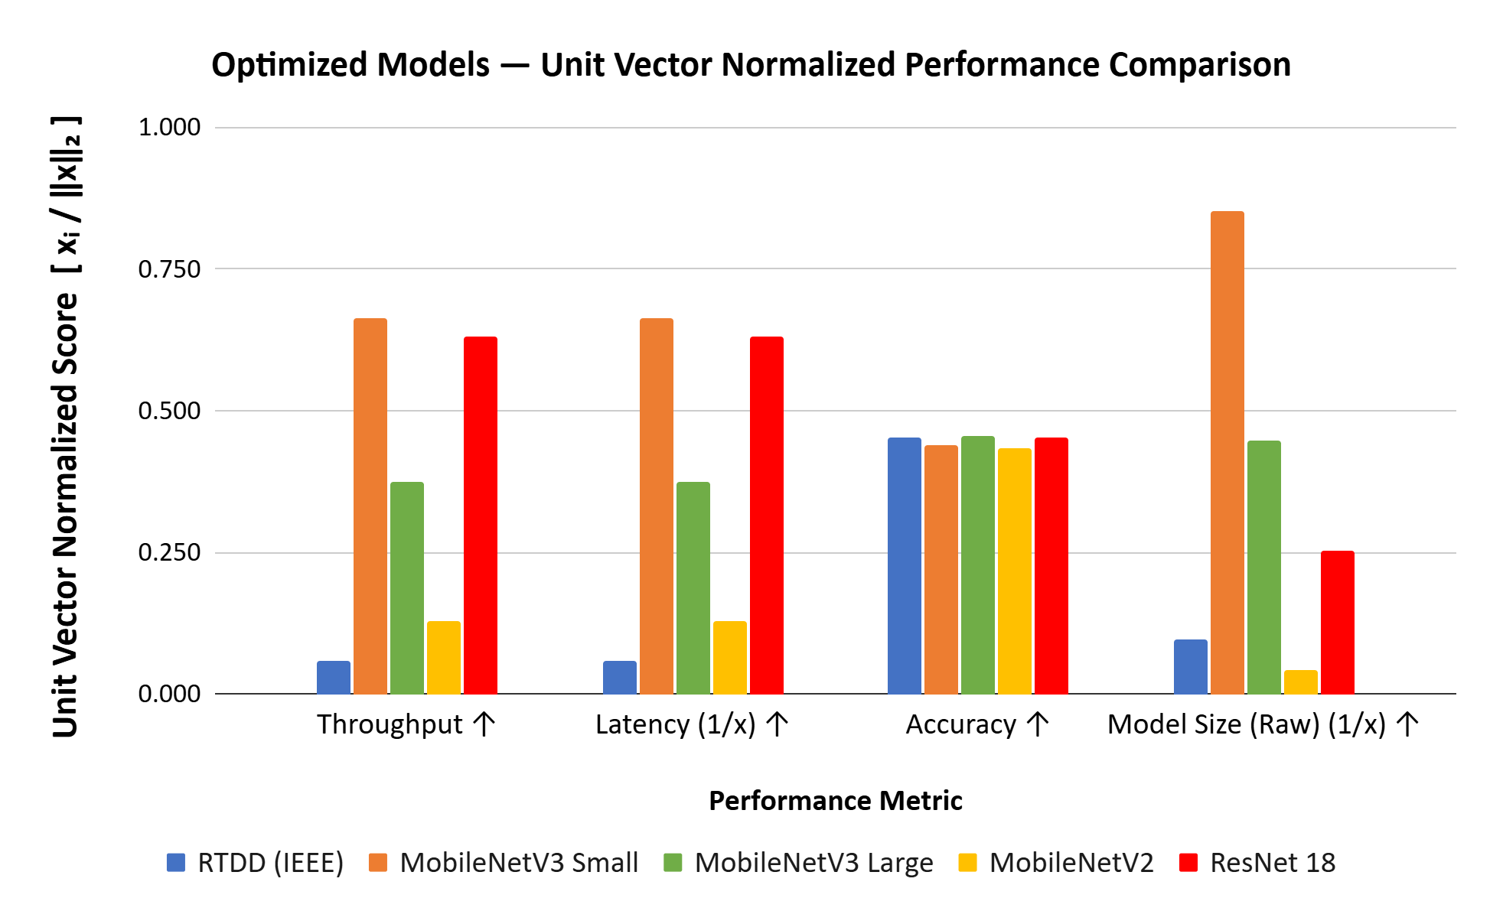
Optimized Model Selection for Edge Deployment
Multi-Metric Benchmarking : All five optimized models were compared across Throughput, Latency, Accuracy, and Model Size using unit vector normalization for fair cross-metric evaluation. MobileNetV3 Small, MobileNetV3 Large, and ResNet 18 consistently ranked as the top three performers.
MobileNetV3 Small — Best Overall Performer : MobileNetV3 Small ranked best in 3 out of 4 metrics, achieving the highest throughput (80.38 img/s), lowest latency (12.44 ms), and smallest model size (3.18 MB), making it the most suitable model for edge deployment.
ResNet 18 — Final Selection for Hardware Acceleration : ResNet 18 was ultimately selected for deployment on our custom accelerator built using Apache TVM. While MobileNetV3 Small operates in mixed precision — making TVM acceleration code significantly more complex to write — ResNet 18's fully quantized architecture greatly simplified the implementation of the acceleration pipeline, making it the more practical choice for our custom hardware.

Slide 10
TVM Migration to Shakti
TVM Relay Import
Graph Optimization of Mixed Precision Model
AOT Compilation
C Code Generation
Cross Compilation to RISCV
Why TVM?
Initial Setup (TFLM on Shakti CPU) : The TensorFlow Lite Micro (TFLM) framework was initially ported to the Shakti CPU platform.
INT8 Quantization Limitation (TFLM) : Applying INT8 quantization led to a significant accuracy drop (~99% → ~52%) so switched to mixed precision support.
Approach :
Switched to TVM : Since mixed precision models are not supported by TFLM framework.
Graph Optimization : Applied transformations such as SimplifyInference and FoldConstant for improved efficiency.

Slide 11
TFLM Demo

Slide 12
TVM Demo

